Slide 1
















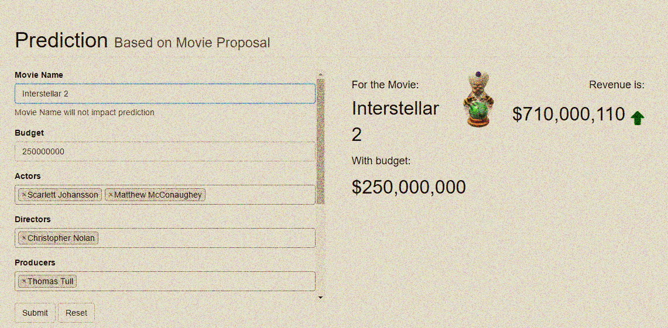


CAN MOVIE REVENUE BE PREDICTED BEFORE RELEASE?
600+ annual Hollywood movies. 50+ Flops. $60 million in losses in 2016.
Losses can be managed with a movie investor assurance system!
To build this system, a new prophet has risen…
The prophet has tamed data
Scraped 45K movies
Discovered its hidden potential
Built 33 features
such as: actor score
Christian Bale | 3.5
Hugh Jackman | 3.1
Adam Sandler | 0.3
Cast multiple spells to train it
K-means Clustering
Random Forest
Gradient Boosting
R-squared value: 0.53
And predicted the future!
$38 billion business globally
$60 million in losses in 2016
movie investor system absent
RELEASING MAY 31, 2017
MOVIE PROPHET
Data Science meets Hollywood
www.movie-prophet.com
CAST: NELSON DSOUZA (nelsonds@uw.edu), MARIA GEORGE (gmaria@uw.edu), SAURABH SETH (sseth12@uw.edu)
PRODUCER
DISTRIBUTOR

